Slide 2
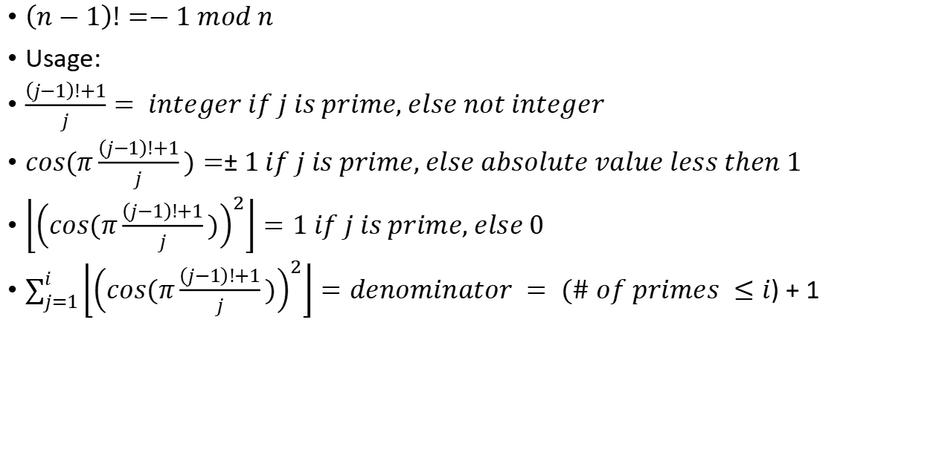
Wilsons theorem and wilsons formula for primes
$\left(n−1\right)!=−1 mod n$
Usage:
$\frac{\left(j−1\right)!+1}{j}= integer if j is prime, else not integer$
$cos(π\frac{\left(j−1\right)!+1}{j})=±1 if j is prime, else absolute value less then 1$
$\left\lfloor {\left(cos(π\frac{\left(j−1\right)!+1}{j})\right)}^{2}\right\rfloor =1 if j is prime, else 0$
$\sum_{j=1}^{i}{\left\lfloor {\left(cos(π\frac{\left(j−1\right)!+1}{j})\right)}^{2}\right\rfloor }=denominator = (\# of primes ≤i)+1$

Slide 3


$$\sum_{a|n}{\frac{1}{a}}=\frac{\sum_{a|n}{a}}{n}$$
for example $\frac{1}{1}+\frac{1}{2}+\frac{1}{4}+\frac{1}{8}=\frac{8+4+2+1}{8}$
360=$2^{3}3^{2}5^{1}$
$\sum_{a|360}{a}=\left(2^{0}+2^{1}+2^{2}+2^{3}\right)(3^{0}+3^{1}+3^{2})(5^{0}+5^{1})=1170$
number of factors, divisible on 360 = (3+1)(2+1)(1+1)=24

Slide 4
p i really awsome prime if for all primes q < p : p+2q is also prime. find largest p
check p = 3 and 7
show that it does not work for p > 7.
for p > 7 we generate digits :
p+2*3 = p+6
p + 2*5 = p+10
p + 2*7 = p+14
because 6 = 0 mod 3, 10 = 1 mod 3 and 14 = 2 mod 3, one of those 3 numbers
must be divisible on 3 .
so there are no really awsome primes for p > 7

